Slide 1


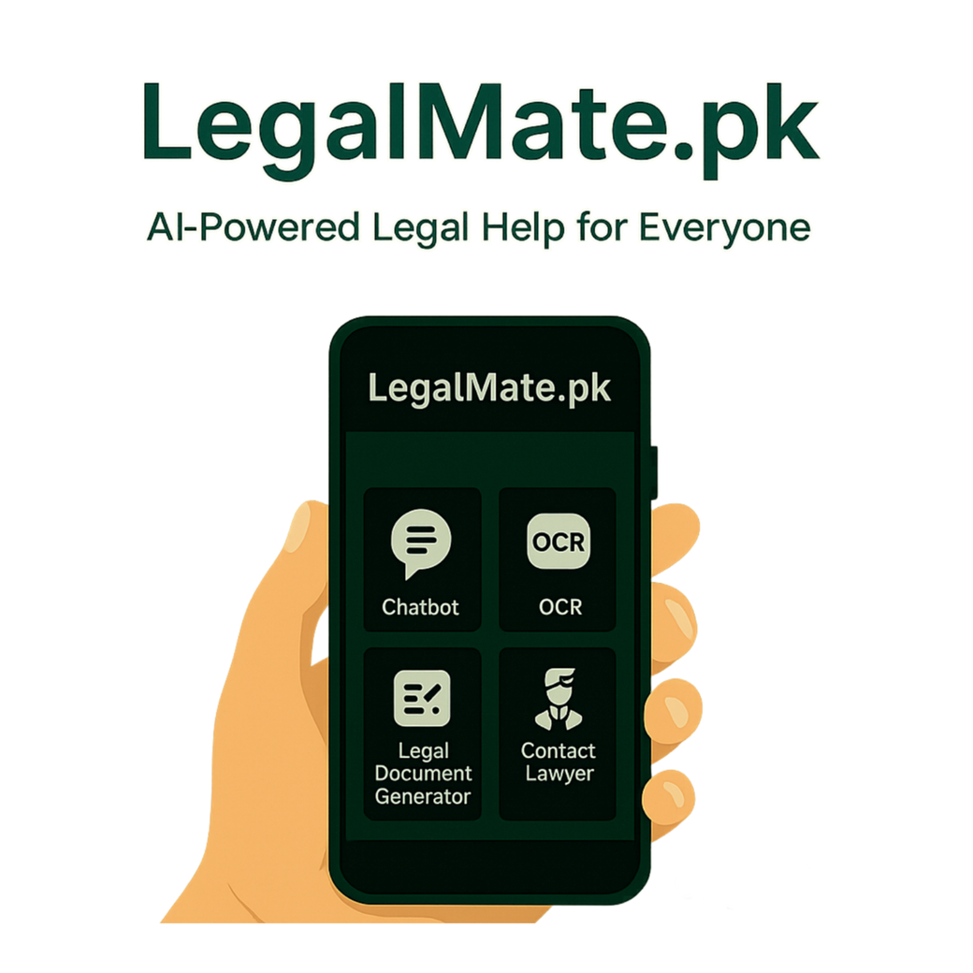
FINAL YEAR PROJECT

Slide 2
PROJECT TEAM
HAROON 45669
SAMEER 47145
SUDAIS 46274
BS COMPUTER SCIENCE
BATCH OF 2022
SUPERVISED BY: Sir Hassaan Siddique
CO-SUPERVISED BY: Dr. Mansoor Alam

Slide 3
Table of Content
Introduction and Background
Literature Review and Summary Table
Problem Statement
Methodology
Progress Report Summary
Requirements
Software System (Design + Implementation + Testing)
Endeavour (Team)
Next Steps
Prototype / Report

Slide 4
INTRODUCTION AND BACKGROUND

Slide 5
INTRODUCTION
Pakistan’s legal system is complex, time-consuming, and costly
Citizens lack awareness of rights, leading to exploitation
Unlike healthcare, transport, and commerce, the legal sector is underserved
Limited digitization of legal resources in Pakistan
Existing platforms mainly serve lawyers, not ordinary citizens

Slide 6
LITERATURE REVIEW & Market Survey

Slide 7
Literature Review
No. | Paper Title | Year | Focus / Domain | Method Used | Tools / Models | Key Results | Limitations
1 | Exploring the State of the Art in Legal QA Systems | 2023 | Legal Question Answering | NLP, Deep Learning, Transformer-based QA models | Legal QA datasets, Deep Learning models | Improved accuracy in answering legal questions using deep learning approaches | Research-focused, lacks deployable system, no domain-specific focus, no document generation or lawyer interaction
2 | Legal Document Generation: Harnessing LLMs for Diverse Legal Workflows | 2024 | Legal Document Automation | LLMs, Prompt Engineering, Multi-Agent System, Templates | Large Language Models, Python libraries | Significant reduction in document preparation time and improved consistency | Template dependency, limited flexibility, mainly enterprise-focused, not user-centric
3 | AI Legal Assistant | 2025 | Criminal Law (IPC-based) | Multimodal AI, NLP, Rule-based structuring | Multimodal LLM, Flask backend | Accurate identification of IPC sections and punishments, improved accessibility | Limited to criminal law, no document generation, no lawyer interaction, web-based only
4 | LawPal: RAG-Based System for Legal Accessibility | 2025 | General Legal Information | Retrieval-Augmented Generation (RAG) | DeepSeek-R1:5B, FAISS | High legal accuracy and reduced hallucinations in responses | No document generation, no lawyer connect feature, research-oriented, web-based
5 | Seeing Justice Clearly: Handwritten Legal Document Translation with OCR and Vision-Language Models | 2025 | Legal document digitization, handwritten text translation (Marathi → English) | Comparative study of OCR + MT pipelines vs end-to-end Vision-Language Models (vLLMs) | Legal datasets, LLM OCR: Tesseract, EasyOCR, PaddleOCR; MT: IndicTrans2, Sarvam-1; vLLMs: Chitrarth, Maya-8B, Ovis2 frameworks | OCR–MT pipelines achieve higher accuracy; vLLMs show potential but low reliability | Research-focused; limited dataset size; vLLMs prone to hallucination; not deployment-ready for real legal use

Slide 8
Market Survey
Project / Org | Target users | Lawyer connect | Retrieval-Augmented Generation (RAG) / statute-aware answers | Urdu & Roman-Urdu support | Voice & OCR inputs | Document generation (fillable templates) | citations shown
VakeelOnline | General public (client ↔ lawyers) | Yes, primary feature is connecting clients to lawyers. | No (search/ marketplace) | Limited (app focused on case matching, language not primary claim) | No | No | No (no evidence of per-answer statute provenance)
Pakistan Law Bot | General public / legal professionals / law students | Some contact/referral features likely | AI chatbot but RAG not used. | No, only translates output | No / OCR- only paid version | Yes, but limited | No
Pak Legal Database (PLD) | Legal professionals / researchers | No (only research tool, not client marketplace) | Yes, Advanced search & research but focused on professional research, not public simplified RAG. | Primarily English/No roman - uses in built google translator | No | Only offer downloadable docs for professionals, not citizen-ready templates. | Yes (provides primary sources/judgments) but not simplified citizen-facing answers.
Pakistan Law Site (repositories) | Researchers, students, lawyers | No | No (Only a legal text repositories) | Primarily English/legal language | No | No | Yes (source texts) but not presented as simplified answers.

Slide 9
Problem

Slide 10



Laws = Complex & Costly
Pakistan’s legal system is complicated, time-consuming, and expensive. Ordinary citizens struggle to understand procedures and often cannot afford professional legal help.
PROBLEM STATEMENT
No User-Friendly Legal Assistant
Unlike healthcare and transport, the legal sector lacks a simple digital solution. Existing helplines (like Citizen Portal) provide complaints support but no legal interpretation or guidance.
Language & Awareness Barrier
Most laws are written in difficult legal English, making them inaccessible for the majority of Pakistanis. There is no platform that explains laws clearly in Urdu or Roman Urdu.

Slide 11
PROPOSED SOLUTION AND METHODOLOGY

Slide 12
We propose LegalMate.pk

Slide 13
What LegalMate Solves
Uses AI to understand legal queries and provide simplified legal guidance
Automatically generates basic legal documents using AI models
Supports text, voice, and OCR inputs for easy access to legal help
Makes lawyer connection easier by guiding users to relevant legal assistance

Slide 14





MAIN FEATURES
Multilingual ChatBot
Voice I/O
OCR & Document Generator
Easy Lawyers Access
Easy laws Explaination

Slide 15
COMPARISON
Project / Org | Target users | Lawyer connect | Retrieval-Augmented Generation (RAG) / statute-aware answers | Urdu & Roman-Urdu support | Voice I/O & OCR inputs | Document generation (fillable templates) | Provenance & statutory citations shown
LegalMate (proposed) | General public (low-literacy + urban/rural citizens) | Yes, verified instant connect + recommendation | Yes, true RAG + Pakistan statute corpus; answers always cite statute/section | Yes, Urdu + Roman-Urdu | Yes | Yes, citizen-facing fillable templates, AI-generated templates | Yes, answer provenance stored & shown

Slide 16
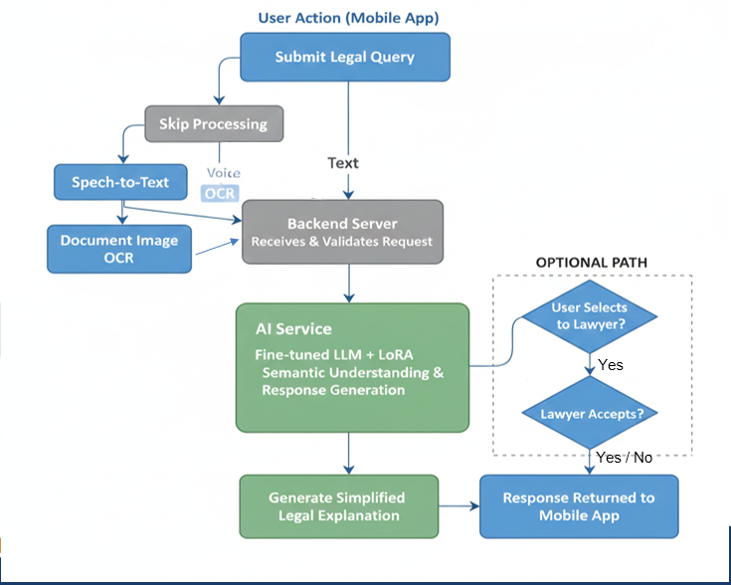
Methodology

Slide 17
Step by Step Flow
User initiates an action through the mobile application
Backend server receives and validates the request
If input is voice or image, it is processed using speech-to-text or OCR
Processed text is forwarded to the AI service
The AI chatbot analyzes the query using a fine-tuned language model

Slide 18
Step by Step Flow
A simplified legal response is generated
The response is sent back to the mobile application
If the user requests lawyer assistance, the query is forwarded to the selected lawyer
Upon acceptance, the lawyer’s contact details are shared with the user

Slide 19
PROGRESS REPORT SUMMARY

Slide 20
Users
General Citizen
Lawyer
Admin

Slide 21
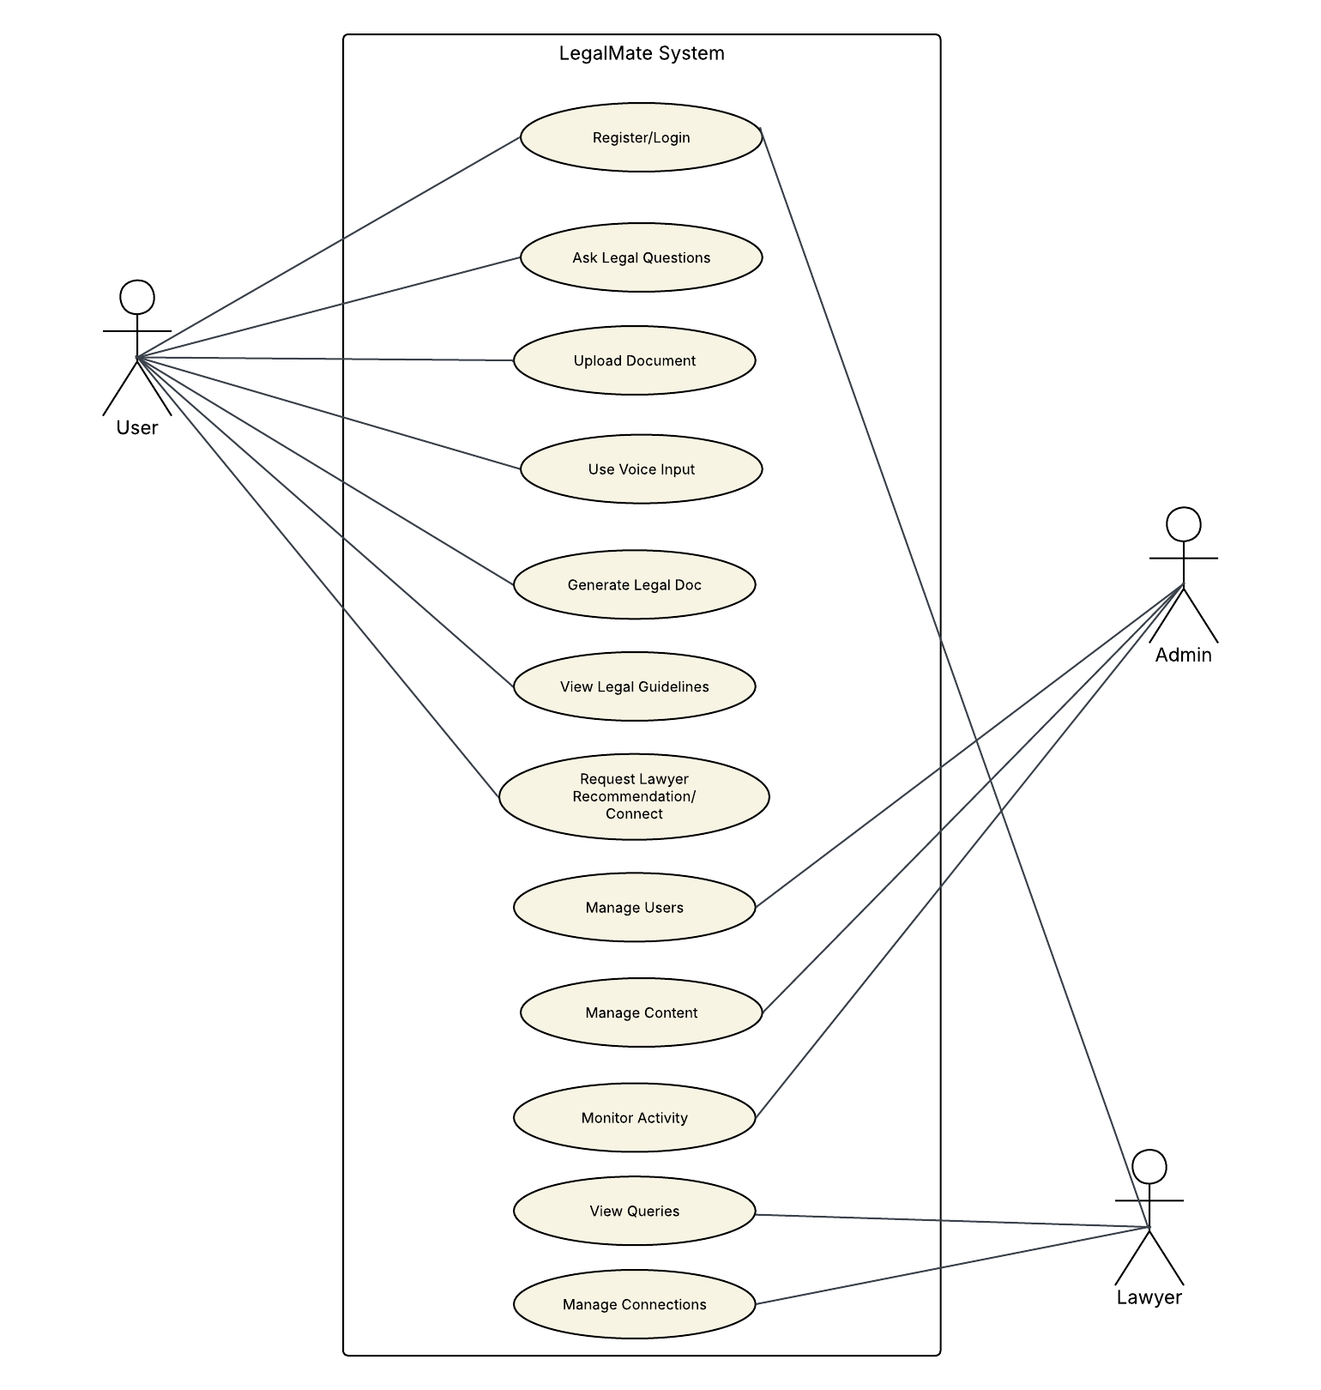
Use Cases / User Stories

Slide 22
Functional Requirements
The system shall
allow users to register and log in securely
accept legal queries in text, voice, and image formats
convert voice input into text
process document images using OCR
generate simplified legal explanations using an AI chatbot
generate basic legal documents in downloadable format
allow users to select and contact registered lawyers
allow lawyers to accept or reject user requests
allow admins to manage users, lawyers, and content

Slide 23
Non-Functional Requirements
The system shall
be user-friendly and easy to navigate
provide timely responses to user queries
ensure data privacy and security
be scalable for future feature expansion
ensure reliable performance under normal usage

Slide 24
Design

Slide 25
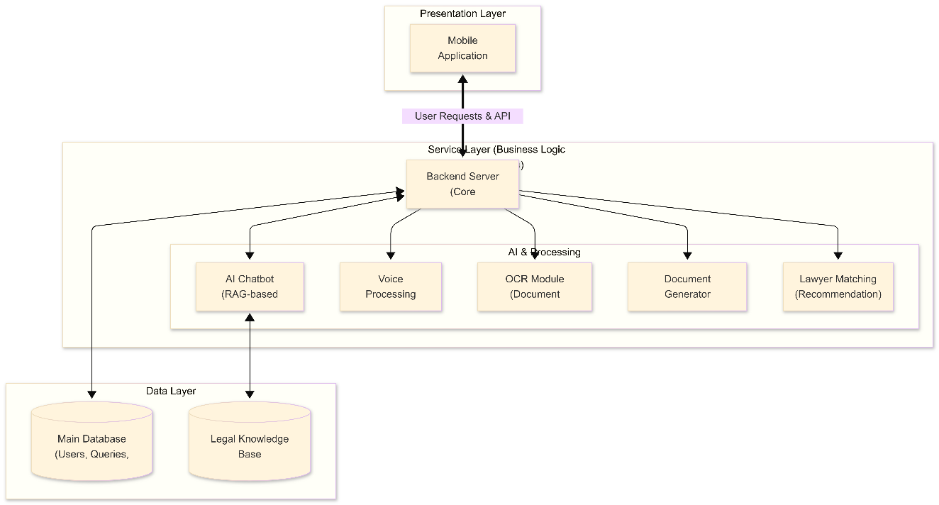
Architecture Diagram

Slide 26
ER-Diagram

Slide 27
Sequence Diagram

Slide 28
Implementation

Slide 29




Development Tools & Technologies
Frontend: Flutter (Dart)
Backend: Node.js
ML Service: Python (FastAPI-based REST API)
Model Training & Experiments:
Google Colab
VS Code
Antigravity
Model Deployment: API-based local deployment

Slide 30

Best Practices / Coding Standards
Modular code structure for backend and ML services
Separation of concerns between UI, backend, and AI service
Use of REST APIs for communication between components
Consistent dataset schema (instruction–input–output format)
Logging and checkpoint-based training for reliability

Slide 31
Libraries / Frameworks / Components
Transformers (Hugging Face)
PEFT (LoRA utilities)
BitsAndBytes (4-bit / 8-bit quantization)
Datasets & Accelerate
FastAPI for AI service
PyTorch for training
TensorBoard for training monitoring

Slide 32
User Interface (Current Status)
A basic mobile user interface has been designed using Flutter
Simple interface for user interaction with the chatbot
Current implementation focuses on connecting the UI with the backend API
Advanced UI features and complete user flows will be implemented in the next phase of the project

Slide 33
Chatbot Implementation Overview
The chatbot is implemented using a fine-tuned large language model
The selected model is Qwen2.5–1.5B-Instruct
The chatbot is deployed as a REST API service
Backend forwards user queries to the chatbot service
The chatbot generates simplified legal explanations and provides legal guidance and assistance

Slide 34
Hardware Environment for Fine-Tuning
Operating System: Windows 11
Python Version: 3.10
GPU: NVIDIA GeForce RTX 3060 (12 GB VRAM)
Ram: 16 GB

Slide 35
Data Collection and Preparation
Data collected from multiple sources including:
Kaggle / Hugging face
GitHub
Pakistani law websites
Data focused primarily on property law
Original data formats included:
PDF documents
Plain text files
Extensive data cleaning and pre-processing were performed

Slide 36
Data Pre-processing
Removal of PDF artifacts and page headers
Cleaning broken formatting and punctuation
Fixing spacing and hyphenation issues
Conversion of plain text into instruction-style format

Slide 37
Synthetic Data Generation
Synthetic data generation was applied using Gemini, to expand the dataset
Seed-based generation was used to maintain format consistency
Generated data followed the same instruction format
Synthetic data was added to balance domain coverage

Slide 38
Dataset Balancing and Size
Final dataset size: 5,000 samples
Dataset distribution:
Property law: 60%
Supreme Court judgments: 25%
Legal UQAD: 10%
General UQAD: 5%
Dataset split:
Training: 4,500 samples
Validation: 500 samples

Slide 39
Data Overview
No. | Dataset Name | Source | Domain Focus | Original Format | Original Samples | Synthetic Data Used | Purpose in Training | Final Contribution (%)
1 | Property Law Dataset | Kaggle, Pakistani Law Websites (PIDE, Mughal Barristers, Wirasat, NDMA) | Pakistani Property Law | PDF, Plain Text | 411 | Yes | Core domain knowledge for property laws, rights, procedures, and disputes | 60%
2 | Legal UQAD Dataset | GitHub | Legal Question Answering | Plain Text | 990 | Yes | Learning legal question/answer structure and legal reasoning | 10%
3 | Supreme Court Judgments Dataset | Kaggle | Judicial Decisions (Pakistan) | PDF, Plain Text | 75 | Yes | Exposure to real court language and judgment reasoning | 25%
4 | General UQAD Dataset | Hugging Face | General Question Answering | Plain Text | 27 | Yes | Maintaining general reasoning ability and response fluency | 5%

Slide 40
Fine-Tuning Process
Model fine-tuned using QLoRA technique
Training performed for 2 epochs
4-bit quantization used to reduce memory usage
LoRA adapters trained instead of full model weights
Training progress monitored using validation loss

Slide 41
Conversation Management & Response Generation
Chatbot uses a generative AI approach
User queries are processed independently
The model performs semantic understanding of queries
Responses are generated dynamically (not template-based)
The system returns clean, user-facing responses only

Slide 42
Testing
Testing Approach
Formal end-to-end system testing has not been completed yet
Current testing is based on:
Validation samples used during model fine-tuning
Training and evaluation logs generated by the training process
Testing focused on:
Response quality
Legal relevance

Slide 43
Training stability
Validation-Based Evaluation
A validation set of 500 samples was used during fine-tuning
These samples were not used in training
The model generated responses for validation prompts
Generated outputs were compared with reference responses
Training Log Summary
Initial training loss ≈ 2.19
Final training loss ≈ 1.51
Validation loss reduced to ≈ 1.53
No training instability or divergence observed

Slide 44
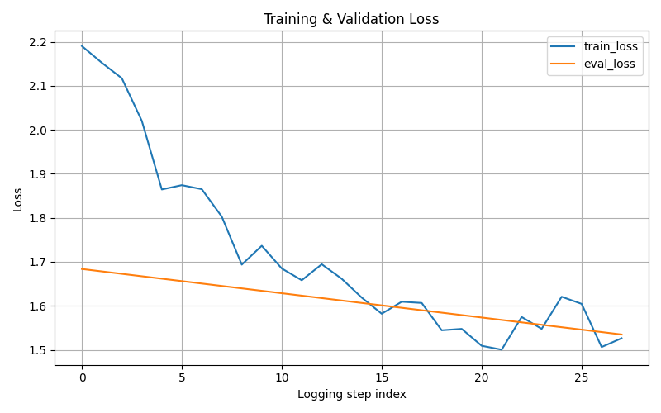
Training & Evaluation Results

Slide 45
ENDEAVOUR

Slide 46
Team Roles
AI & Machine Learning Lead
Dataset collection, cleaning, and preprocessing
Synthetic data generation and dataset balancing
Fine-tuning the Qwen2.5-1.5B model using QLoRA
Evaluation of training and validation results
Backend Developer
Development of Node.js backend services
Integration of AI service APIs with the mobile application
Handling user authentication and request routing
Mobile Application Developer
UI development using Flutter (Dart)
Implementation of chatbot interface, OCR, and voice input screens
Integration with backend APIs

Slide 47
NEXT STEPS

Slide 48

WBS
Problem identification and domain selection (Property Law)
Requirement gathering & dataset collection
Literature Review and research GAP
Dataset Preparation
Chatbot development (Urdu/English)
Basic Flutter UI screens
Simplification engine for laws
Document generation module

Slide 49
OCR integration & summarization
Lawyer recommendation system
Lawyer connect
Python-based AI service (FastAPI)
Node.js backend integration (partially)
FYP-1 report and diagrams
Implementation & results documentation
Voice input/output support
Testing & evaluation
Deployment & user feedback

Slide 50
WORK DIVISION TIME LINE
Sep-Nov
Frontend & User Experience
Query Classification + RAG Setup
Dec-Feb
Legal Knowledge Base (simplified laws
OCR Integration & Testing Module
Mar-Apr
Automated Document Generator (UI + flow)
Backend Optimizations + Data Security Module
Admin Dashboard Implementation
AI Chatbot Urdu/English
Voice Input/Output & Notifications System
May-Jun
Frontend Enhancements & User Profile Management
Payments & Billing System Integration
Lawyer Recommendation Engine

Slide 51
Challenges
Data: Limited legal datasets, need expert validation.
Language: Urdu/Roman Urdu NLP immature, code-mixing issue.
Legal: Cannot replace lawyers, only guidance.
Technology: OCR errors, high computational cost.
Ethics: Privacy risks, misuse of auto-generated docs.
Adoption: Connectivity gaps, low initial trust.

Slide 52
PROTOTYPE & REPORT

Slide 53
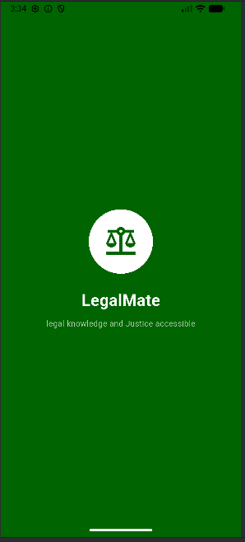
Prototype

Slide 54
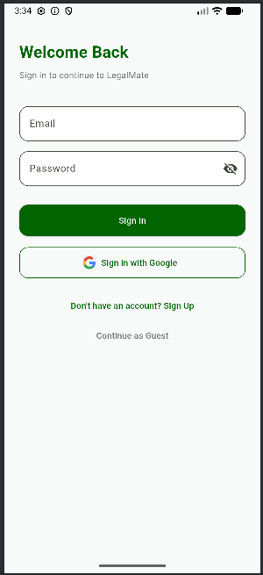
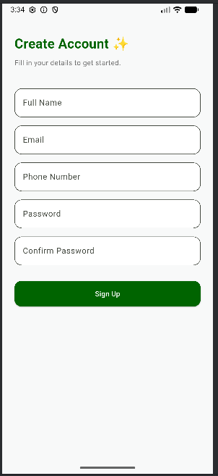
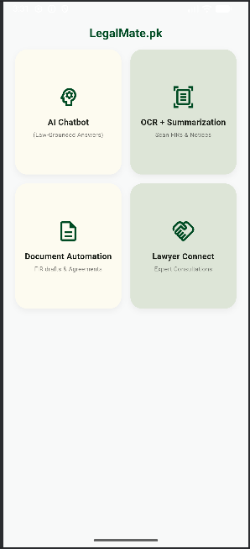

Slide 55
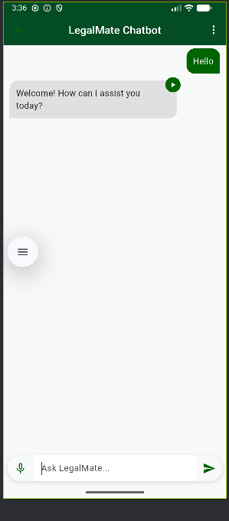
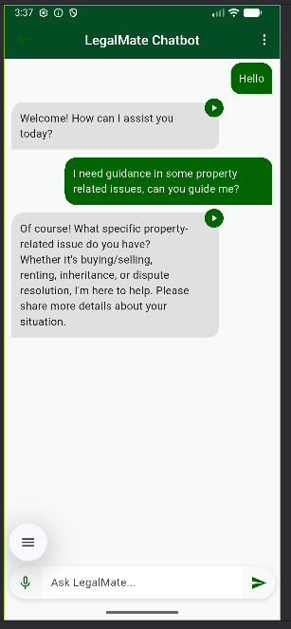

Slide 56
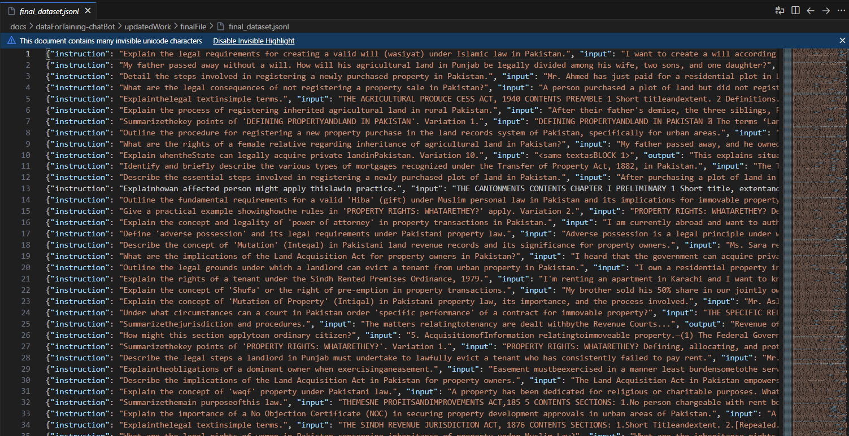
Appendix
Type of data used for fine tunning

Slide 57
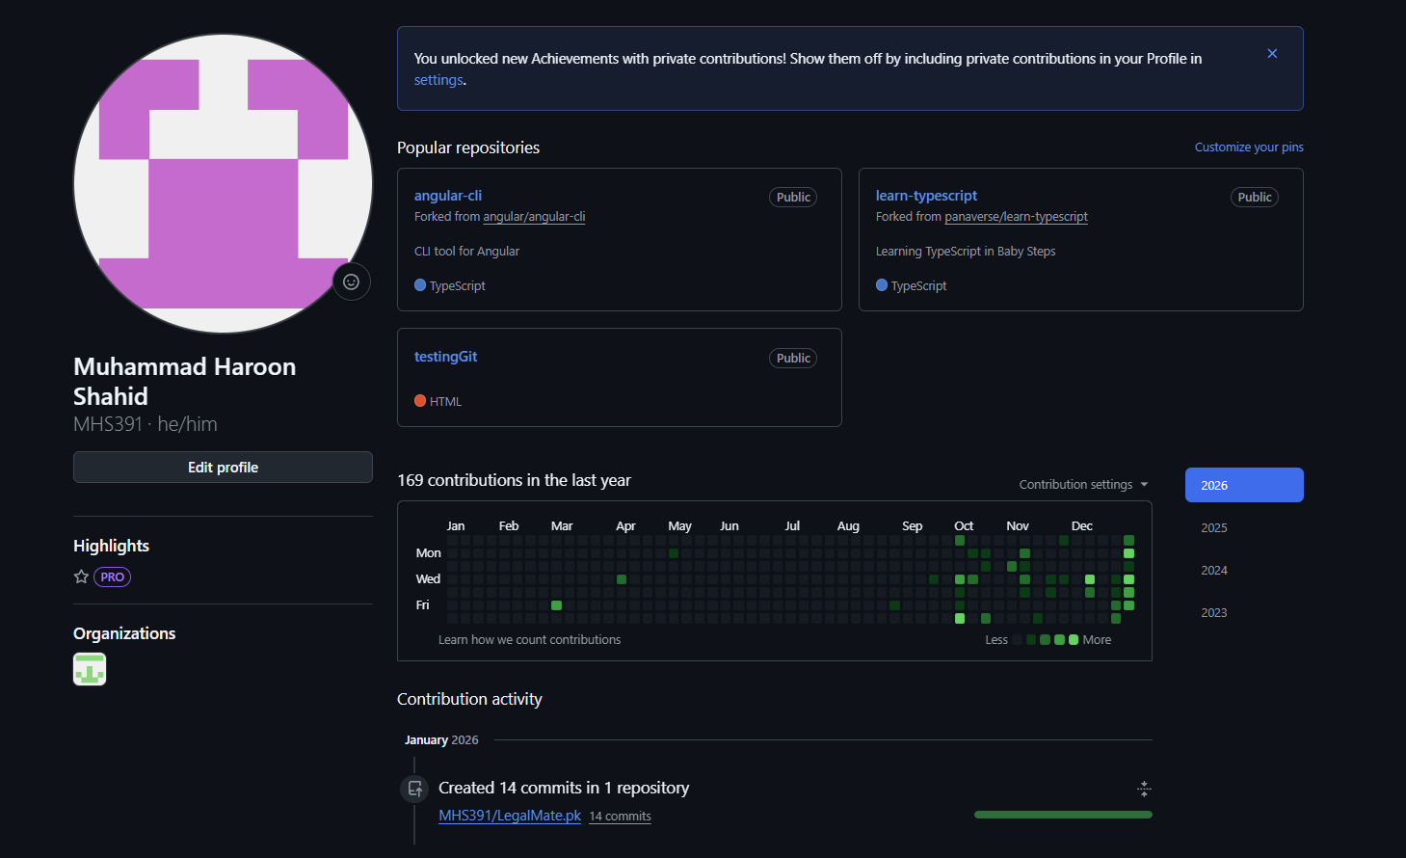
Appendix
Git Dashboard

Slide 58
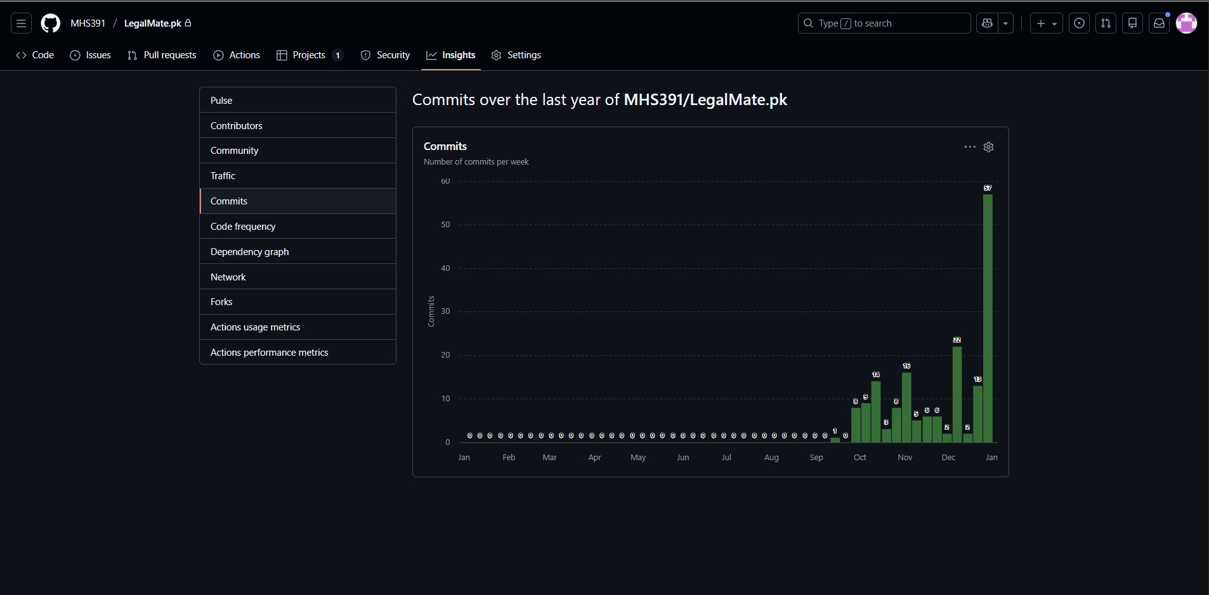
Appendix
Repository Commits

Slide 59
Report
Chapter 1: Introduction
Chapter 2: Literature Review / Market Survey
Chapter 3: Requirements and Design
Chapter 4: Implementation and Test Cases
Chapter 5: Experiment Results and Analysis
Chapter 6: Conclusion & Future Direction

Slide 60


